Slide 1
Deploy Java Spring Boot Microservices with Docker & Docker Compose SWATHI ROKKALA, 23221A05A2, BVC ENGINEERING COLLEGE, (Batch -1) SHERU LALITHA SREE, 23221A05B1, BVC ENGINEERING COLLEGE, (Batch -1) KUNCHANAPALLI JASHUVA, 23221A0493, BVC ENGINEERING COLLEGE, (Batch -1) HIMA PRAVEENA PULLETIKURTHI, 23221A0594, BVC ENGINEERING COLLEGE, (Batch -1) MAGAPU SANKEERTHANA, 23221A0572, BVC ENGINEERING COLLEGE, (Batch -1)

Slide 2
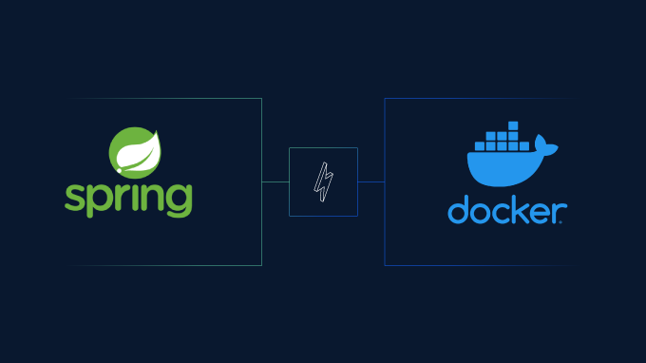
1. Introduction to the Solution
2. Why Dockerize Microservices?
3. Dockerizing the Ledger Service
4. Dockerizing the Transfer Service
5. Connecting the Services
6. Using Docker Compose
7. Scalability & Future Improvements
8. Demo & Wrap-Up
AGENDA

Slide 3
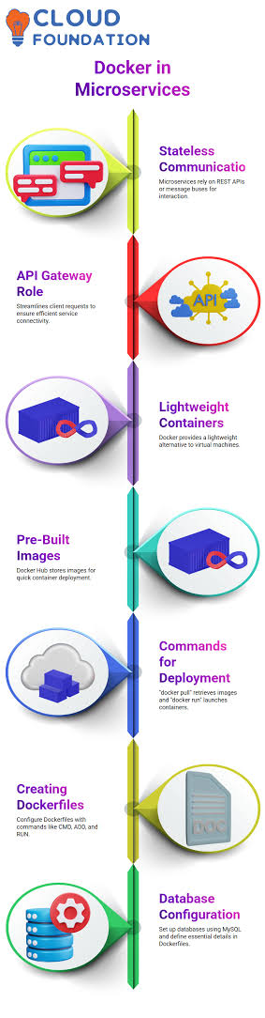
Why Dockerize Microservices?
Consistency:
Runs the same everywhere (dev, test, prod)
Isolation:
Each services packaged with its dependencies
Scalability:
Scale services independently
Portability:
Depoly on any cloud or on-prem server

Slide 4
Introduction to the Solution
Core Services:
Ledger Service: Maintains account balances and logs transactions.
Transfer Service: Handles money transfers and communicates directly with the Ledger Service.
Technology:
Built with Java 17 and Spring Boot.
Designed using REST APIs for seamless inter-service communication.

Slide 5
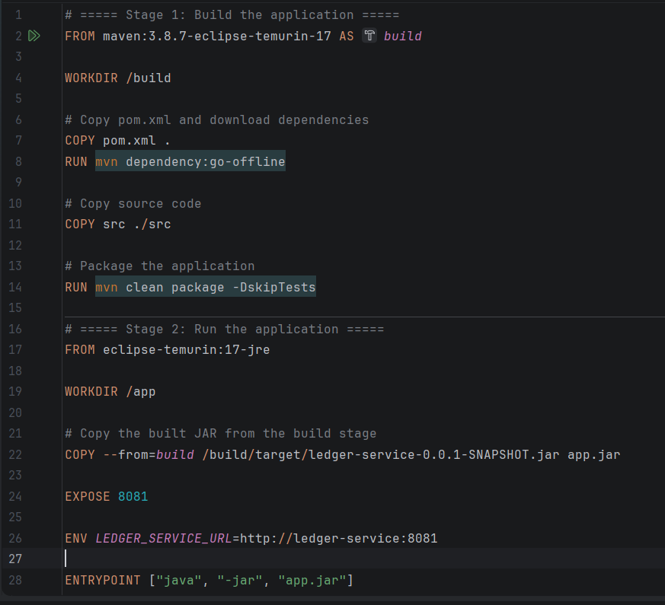
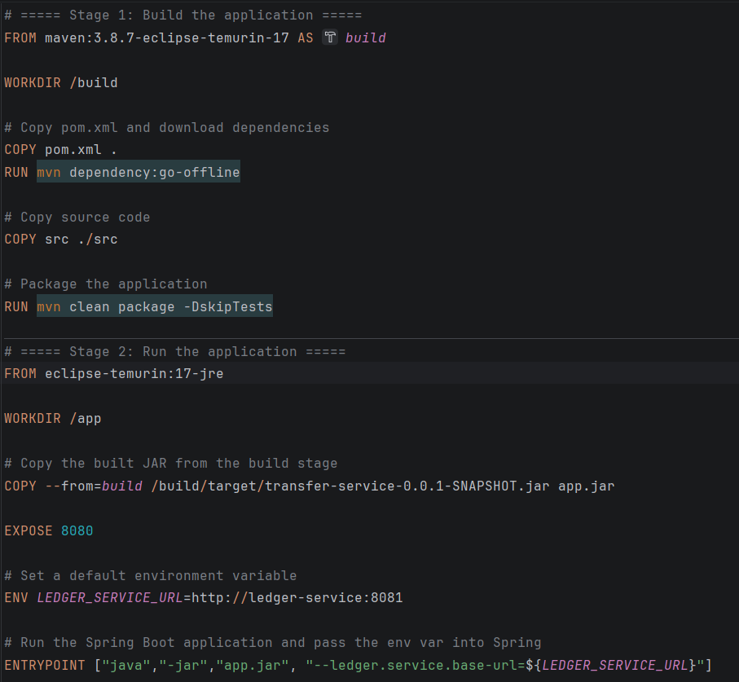
Dockerizing the Services
Dockerizing the Ledger Service:
Packages the foundational data layer.
Dockerizing the Transfer Service: Packages the operational engine layer.

Slide 6
Connecting the services
The Localhost Problem: By default, the Transfer Service uses: String baseUrl = "http://localhost:8081"; Inside a Docker network, containers are isolated and do not share. The Docker Solution: Services communicate using dynamic container service names. Updated route: String baseUrl = "http://ledger-service:8081";

Slide 7
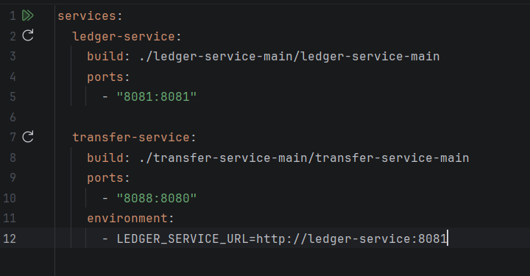
Using Docker Compose
Version:”3.9”service
ledger-service:
build: ./ledger-service
container_name: ledger-service
ports: ”8081 :8081”
Transfer service:
build: ./transfer-service
container_name: transfer-service
ports: ”8080:8080”
depends_on: ledger-service
environment: LEDGER_BASE_URL: http://ledger-service:8081

Slide 8
Scalability & Future Improvements
Load Balancing: Introduce an API Gateway to manage incoming traffic.
Database Integration: Replace in-memory data structures with a persistent database like PostgreSQL
Monitoring: Add tools like Prometheus or Grafana to track container health.

Slide 9
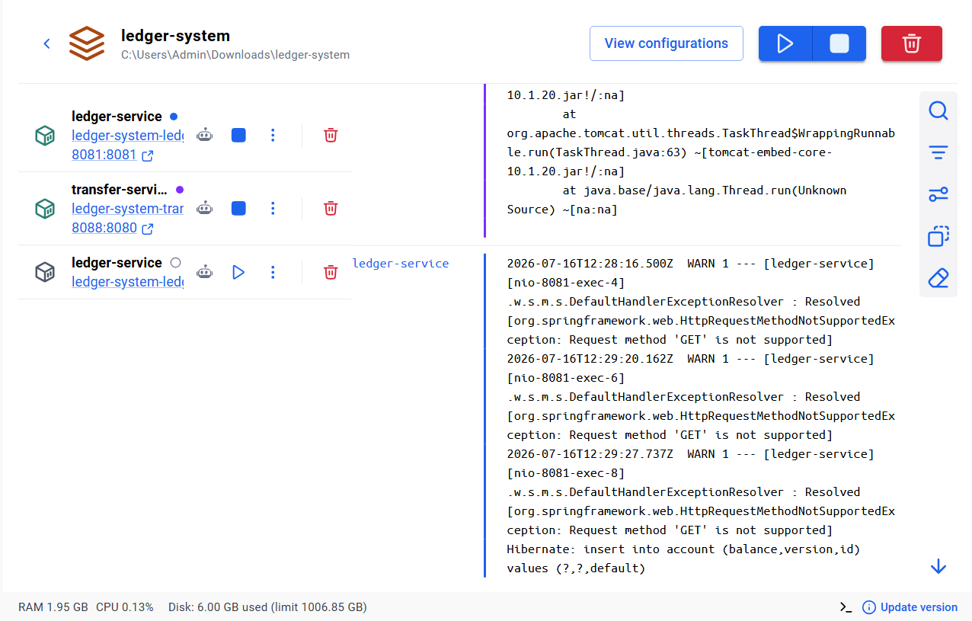
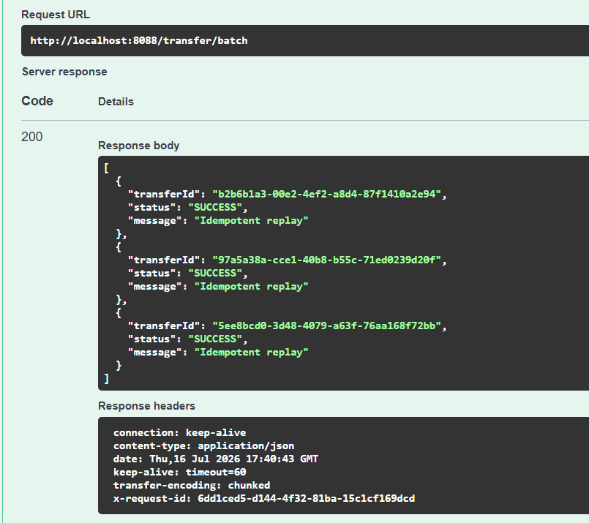
Live Demonstration

Slide 10
Thank you SWATHI ROKKALA, 23221A05A2, BVC ENGINEERING COLLEGE, (Batch -1) SHERU LALITHA SREE, 23221A05B1, BVC ENGINEERING COLLEGE, (Batch -1) KUNCHANAPALLI JASHUVA, 23221A0493, BVC ENGINEERING COLLEGE, (Batch -1) HIMA PRAVEENA PULLETIKURTHI, 23221A0594, BVC ENGINEERING COLLEGE, (Batch -1) MAGAPU SANKEERTHANA, 23221A0572, BVC ENGINEERING COLLEGE, (Batch -1)

